Slide 1
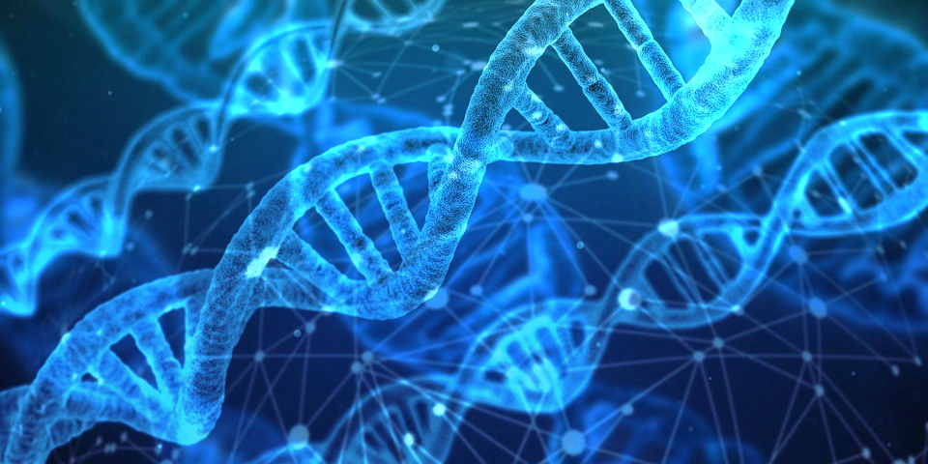
Genetic Algorithms
DATA MINING & MACHINE LEARNING
Mariah Bastos
Rene Villarreal

Slide 2
Define the topic
It is used to generate solutions for problems that to which we have no way to calculate a solution .
It is part of evolutionary algorithms
use natural selection to approximate solutions to a given problem

Slide 3
explain the details
used the population of possible solutions
each population has a genom that encodes the solutions
it is a binary coding of the content of the population
the generation

Slide 4
describe how the approach has progressed Data Mining and Machine Learning

Slide 5
discuss examples of its wide-spread use

Slide 6
Summarize a published paper

Slide 7
explaining the paper's problem

Slide 8
motivation

Slide 9
methodology in terms of the approach

Slide 10
results

Slide 11
impact

Slide 12
conclusion

Slide 13
basic coding demonstration
describe the problem we will be solving and explain the code (line-by-line) and data.

